Slide 1



SELF CAREER PREDICTION SYSTEM FOR STUDENTS
TEAM MEMBERS:
210701115-KAVIPRIYA B
210701128-LAKSHASRI D P
210701262-SRUTHI S

Slide 2


TABLE OF CONTENTS
01
Introduction
02
Problem Statement and Motivation
03
Objective
04
Abstract
05
Architecture Diagram
06
List of Modules
07
Implementation
08
Results
09
Conclusion
10
References

Slide 3

INTRODUCTION
The self-career prediction tool uses complex algorithms to find hidden patterns in student data. It goes beyond traditional methods by considering factors like favorite subjects and socioeconomic background. By comparing the profile to successful individuals, it can suggest subjects that the user might excel in and careers that align with your passions. This ever-learning system improves with new data, constantly refining its predictions. The benefits are two-fold: students gain valuable insights for their academic and professional journey, while schools can personalize counseling and support programs based on student needs. This technology empowers students, schools, and ultimately, the future workforce.

Slide 4

PROBLEM STATEMENT AND MOTIVATION
Develop a website using open-source data as career guidance and job recommender for aspiring youth that acts as skill or job recommender transforming career guidance by leveraging technology to match individuals with suitable jobs fostering efficient employment and career development.
This project aims to develop a machine learning-based recommender system to help college students identify suitable career paths by analyzing their skills, interests, and academic performance. Using a neighbor-based approach, the system learns from the professional journeys of similar students, providing targeted and justified recommendations.

Slide 5

UNDERSTANDING
OBJECTIVE
GOAL OF PROJECT
The Career Guidance website project aims to create an accessible platform that connects education and job services, promoting ﻿career development and lifelong learning. Utilizing advanced algorithms and data-driven insights, the app provides individualized career advice to help users make well-informed career decisions.
Facilitating Informed Decision-Making:
The system should help students make well-informed decisions about their career paths by providing comprehensive information about different industries, job roles, educational pathways, and skill requirements.
Exploring Diverse Career Options:
The system should expose students to a wide range of career options, including emerging fields and non-traditional career paths, allowing them to explore and consider a variety of opportunities beyond conventional choices.

Slide 6
ABSTRACT
Choosing the right career is a crucial yet challenging decision for college students. This project addresses this issue by creating a machine learning-based recommender system that analyzes students' skills, interests, and academic performance to suggest suitable career paths. Using a web app built with HTML, CSS, JavaScript, Flask, PHP, and KNN, the system forms multidimensional student profiles and identifies the K most comparable students to provide personalized career recommendations based on their professional histories. This adaptive method offers clear, data-driven guidance to help students make informed career choices.

Slide 7
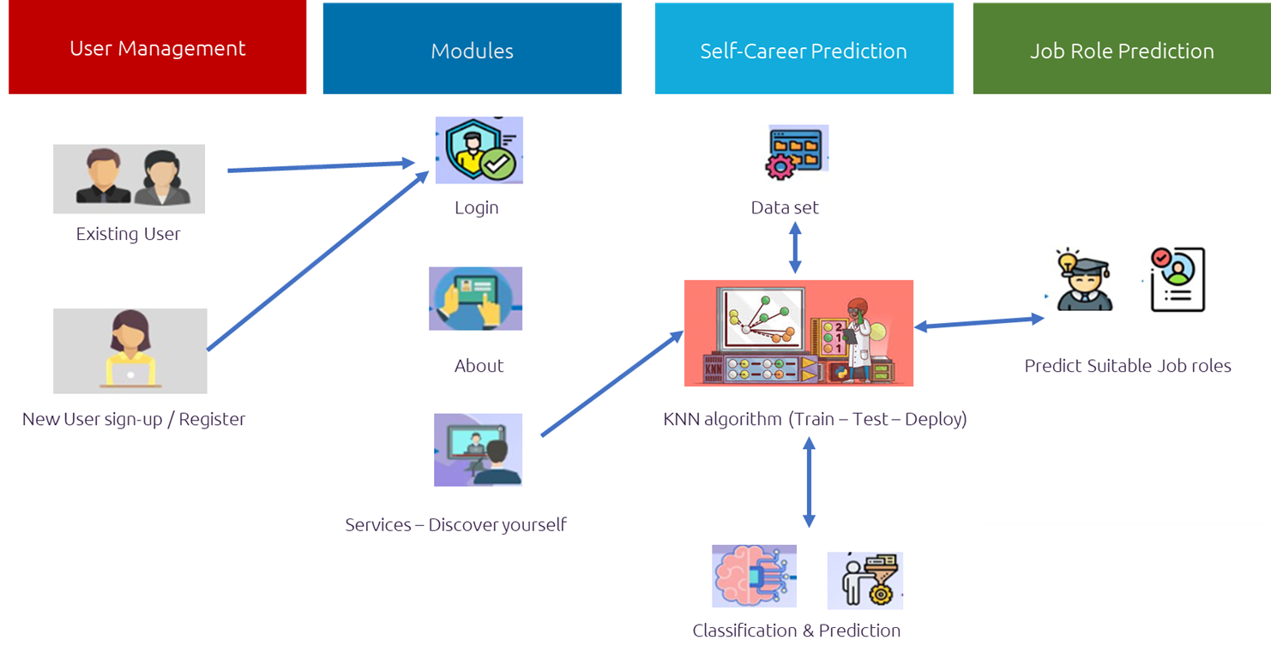
ARCHITECTURE DIAGRAM

Slide 8


LIST OF MODULES
Registration and Login
Discover yourself
Data Preprocessing
Predicting the Skills
Recommend the respective skill
Knowledge Networking

Slide 9
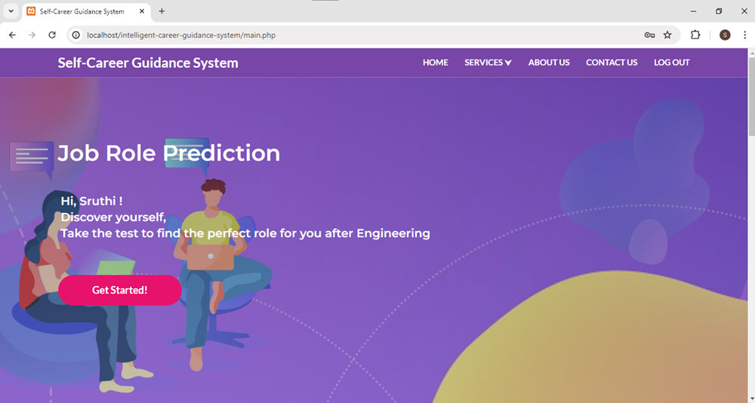
IMPLEMENTATION

Slide 10
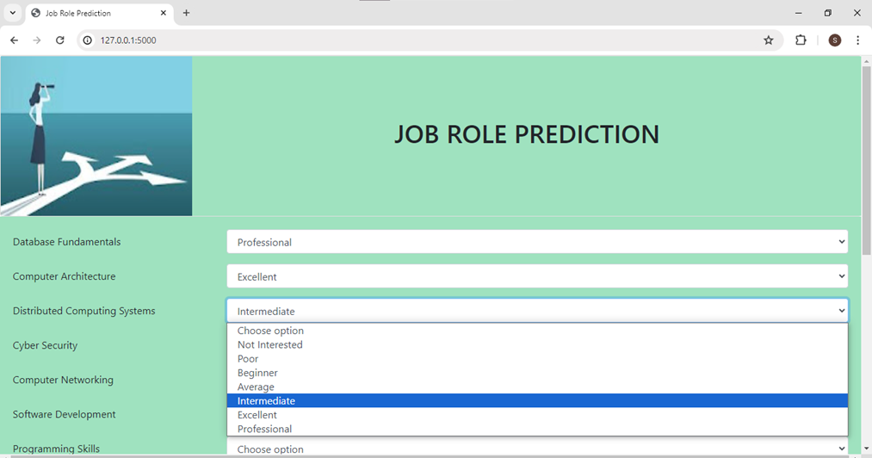
IMPLEMENTATION

Slide 11
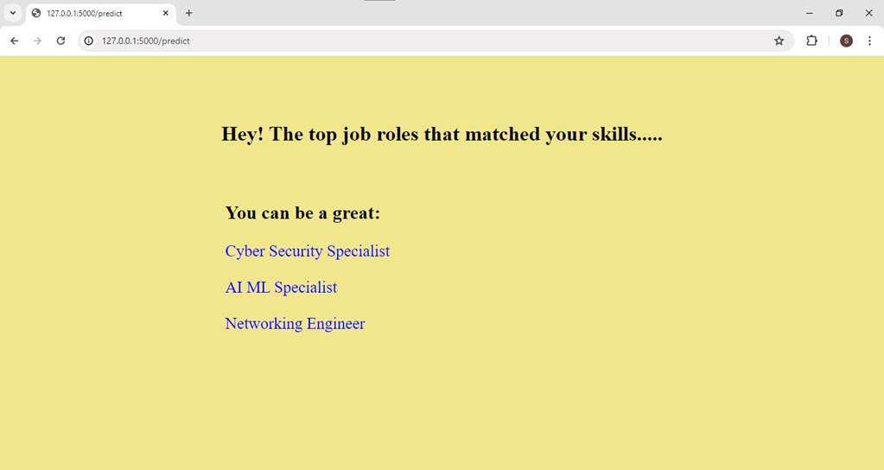
IMPLEMENTATION

Slide 12
RESULT
With the aid of this career advising system, students can navigate their future with a holistic approach. Students can access a variety of features by just registering and logging in. Self assessments and AI/ML are used in the "Discover Yourself" section to generate unique student profiles. In the background, machine learning algorithms prepare data for analysis and forecast a student's innate abilities. Then, based on this data, particular job roles are suggested. Lastly, the knowledge networking module promotes a collaborative learning environment by enabling students to access and contribute career-related information. With the use of machine learning, information sharing, and self-discovery tools, this system gives students the ability to make well-informed career decisions.

Slide 13
CONCLUSION
This career coaching method equips students with tools for confident decision-making by integrating a knowledge-sharing platform, K-Nearest Neighbors (KNN) machine learning, and self-discovery exams. It enhances self-awareness through profile creation and assessments, offers personalized guidance via KNN analysis, and supports informed decisions with concise justifications. This framework fosters self-discovery and empowers students to take charge of their future.

Slide 14

REFERENCES
[1] R. Afarian, B.H. Kleiner The relationship between grades and career success Management Research News, 26 (2003), pp. 42-51.
[2] Lindsay, K. Tsey, B.S. Malau-Aduli A systematic review of factors that influence youths career choices: The role of culture Frontiers in Education, 3 (2018), pp. 307-319.
[3] C.C. Chan Social support, career beliefs, and career self-efficacy in determination of Taiwanese college athletes' career development Journal of Hospitality, Leisure, Sport and Tourism Education (2020)
[4] M.S. Neill Accredited vs. non-accredited: How accreditation impacts perceptions and readiness to provide ethics counsel Public Relations Review (2016)
[5] J. Haushofer, E. Fehr On the psychology of poverty Science, 344 (2014), pp. 862-867
[6] A. Bandura Social Foundations of Thought and Action: Social Cognitive Theory, Prentice Hall, Upper Saddle River, NJ (1986)
[7] S. Brown et al. Critical ingredients of career choice interventions: More analyses and new hypotheses Journal of Vocational Behavior (2003)
[8] B.K. Bryant et al. Parenting in relation to child and adolescent vocational development Journal of Vocational Behavior(2006)
[9] T. Asparouhov, B. Muthén Auxiliary variables in mixture modeling: Using the BCH method in Mplus to estimate a distal outcome model and arbitrary secondary model Mplus Web Notes, 21 (2015)
[10] N. Bozionelos et al. Enhancing the sustainability of employees' careers through training Journal of Vocational Behavior (2020)

Slide 15
GITHUB LINK
https://github.com/SruthiS03/210701262-CS19621-PRIEE.git

Slide 16

THANK YOU

